Slide 1

PEACE ASSEMBLY (Values-based Education approach)
Please feel free to adapt this assembly to the context of your school. There are notes at the bottom of many slides.
Delete slides which are less relevant and add images etc of your setting. Some slides are more suited to EY/KS1/KS2 etc.
The images have all been purchased, or are copyright free or are licensed under a Creative Commons Attribution Share-Alike 3.0 License.
If you have any feedback or suggestions for VbE, please get in touch: info@valuesbasededucation.com
This is a Powerpoint Presentation.
Make sure you ‘Run as a Slideshow’ for animations and links etc to work.

Slide 2
Date………………………….
School
logo here
Welcome to our
Values Assembly
Notes:
Please run this assembly as a slide show to access animations and hyperlinks.

Slide 3
This month’s Values song is…
‘Imagine’
by John Lennon
Notes:
Click on heart to play - hyperlink to
http://www.youtube.com/watch?v=yRhq-yO1KN8

Slide 4
A value is a principle
that guides our thinking and behaviour.
  Let’s reflect on how thinking about (enter previous month’s value) did this?
Notes:
Time for a moment of reflection while children and staff think about how the value has shown in their lives during the last month.
Encourage them to think of how it affected their own thinking and behaviour and also that of other people.

Slide 5

  Let’s remind ourselves of all the values we have in our
  Values Toolkit so far…

Slide 6


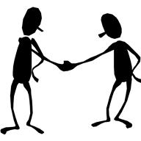

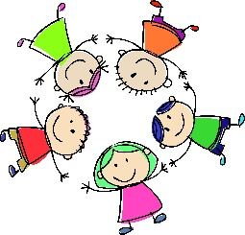

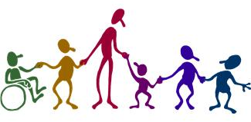

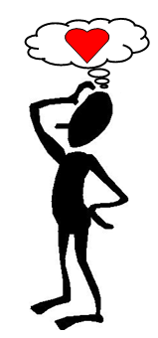
Love
Compassion
Respect
Kindness
Responsibility
Friendship
Peace
Equality
Courage
Hope
Consideration
Notes:
Re-cap on previous values.
Talk about building your ‘values toolkit’ and using them all the time.
Delete those which haven’t been explored yet and/or replace with different values as appropriate.
If you are in the second cycle, recap on all of the values from the first cycle.

Slide 7
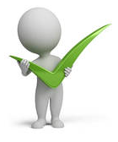










Positivity
Trust
Honesty
Self belief
Self control
Pride
Confidence
Tolerance
Empathy
Patience
Determination
Notes:
Re-cap on previous values.
Talk about building your ‘values toolkit’ and using them all the time.
Delete those which haven’t been explored yet and/or replace with different values as appropriate.
If you are in the second cycle, recap on all of the values from the first cycle.

Slide 8
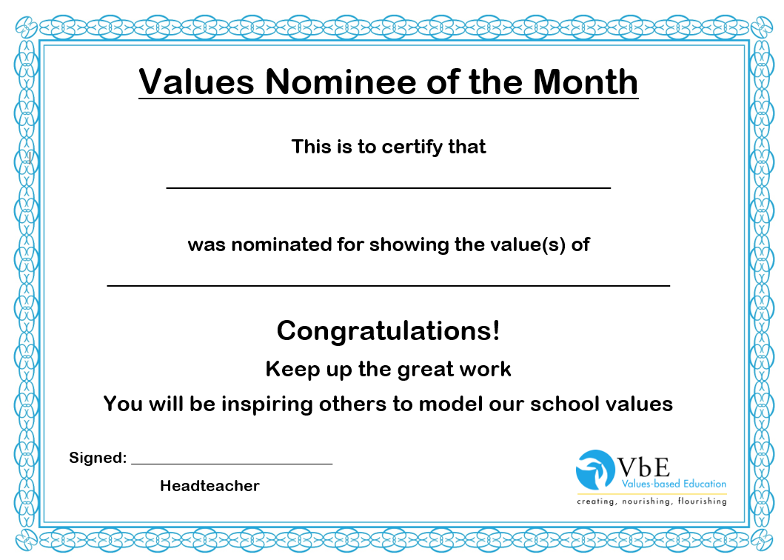
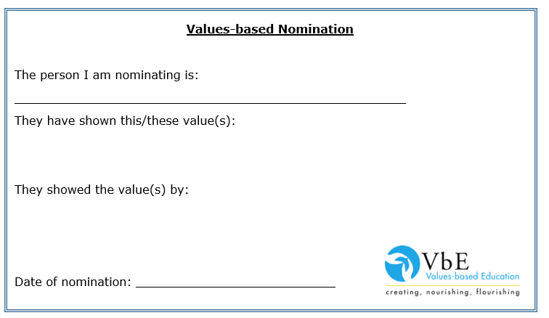
Notes:
These resources are available for Members in the Resources section.

Slide 9
This month we will be exploring the value of …
  Peace

Slide 10
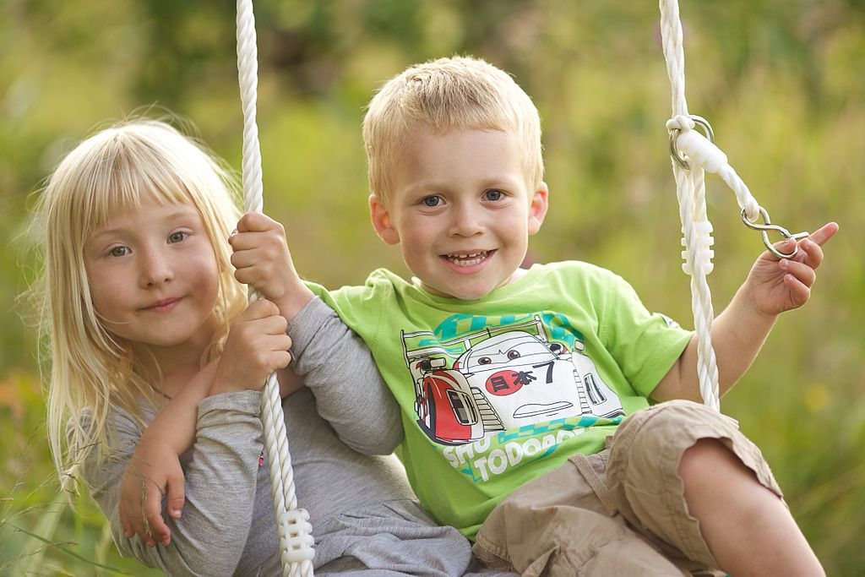
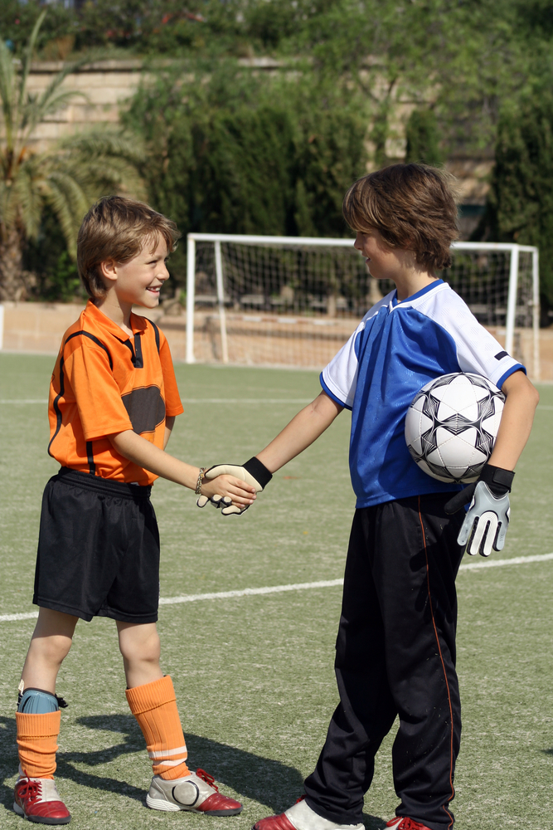
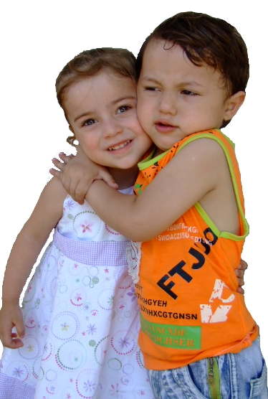
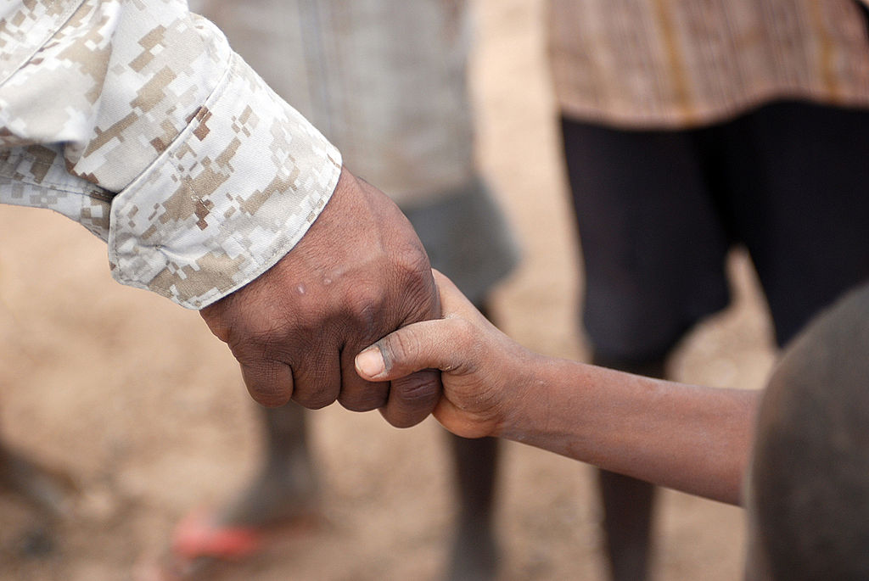
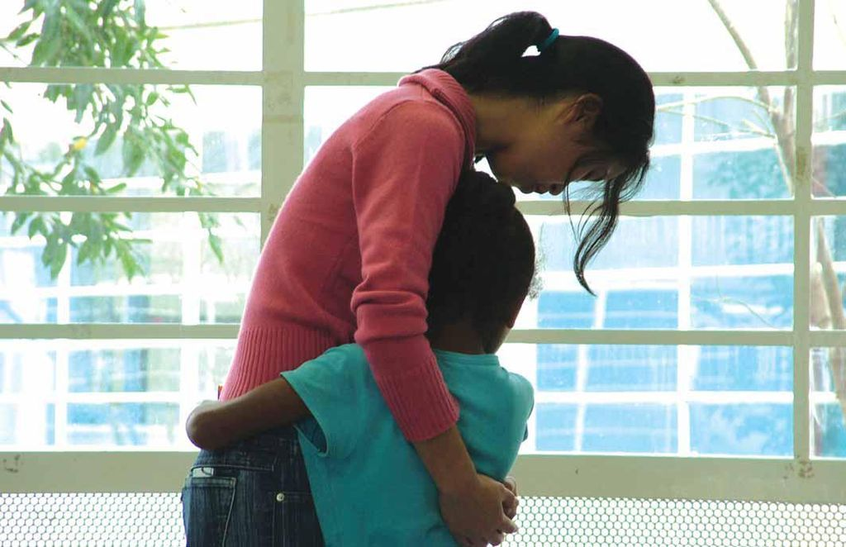
Notes:
We see peaceful behaviour everywhere.
People of the same – or different – ages, cultures, races, genders, religions, football teams!
Everyone can be peaceful towards another person.
Suggestions:
Replace with photos of pupils showing peaceful behaviour.
Invite pupils to make their own Peace Photo collages

Slide 11
  What does peace mean to you in these places or with these people?
religious
places
school
home
friends
classmates
community
staff
family
Notes:
For discussion

Slide 12

  What does the word PEACE mean to you?
Not fighting
Not arguing
Not being selfish
Not bullying
Notes:
Much better to turn into positive statements – see next slide
12

Slide 13
  What does the word PEACE mean to you?
Showing love
Showing compassion
Showing respect
Showing kindness
Showing friendship
Showing responsibility
Notes:
13

Slide 14
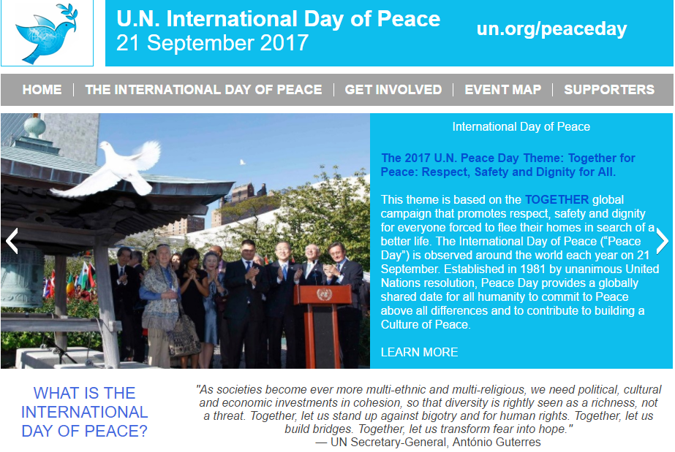
  September 21st (every year!)
  International Day of Peace
Notes:
http://internationaldayofpeace.org/
14

Slide 15
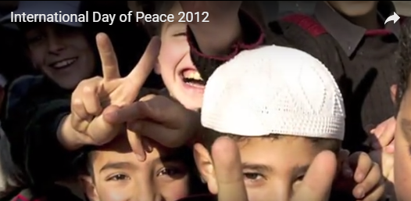

  What is International Day of Peace? – short film
Notes:
Film about International Day of Peace
https://www.youtube.com/watch?v=-BX2Ukn0Qqw
15

Slide 16
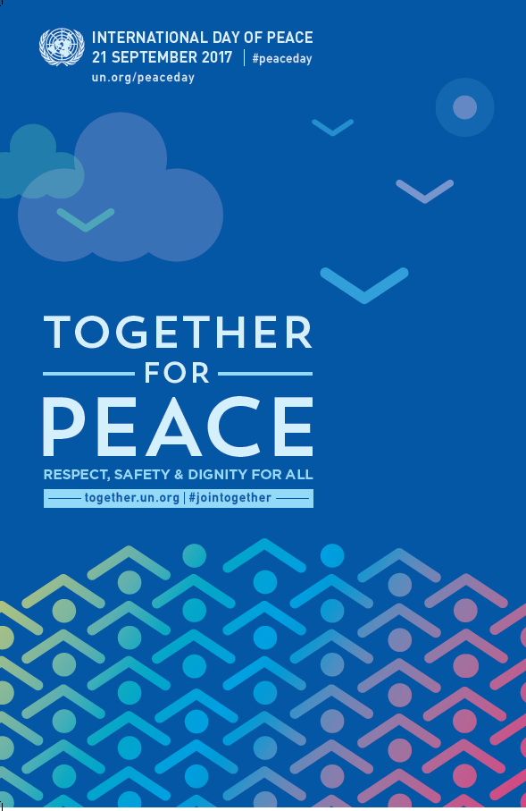
The 2017 U.N. Peace Day Theme:
Together for Peace: Respect, Safety and Dignity for All
Notes:
Download this poster
http://www.un.org/en/events/peaceday/pdf/IDP_2017_Print
16

Slide 17

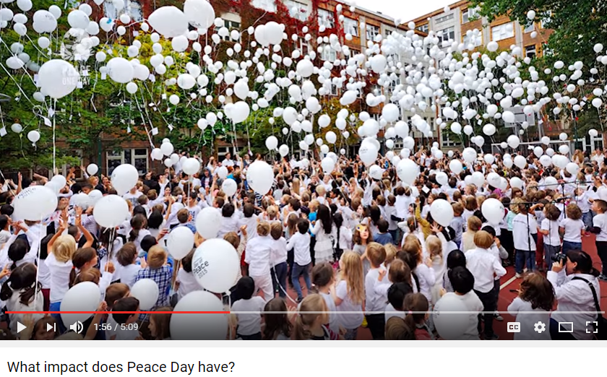
World Peace Day
Thursday 21st September
Watch this film to see the background and impact of Peace One day
Source: Peace One Day (http://peaceoneday.org)
Notes:
Click on the picture to watch a 5 minute film to see the background and impact of Peace One Day
More suitable for KS2/older pupils
https://www.youtube.com/watch?v=w0G_V1jJI_c
Source: Peace One Day (http://peaceoneday.org)

Slide 18
Peace Day 2016… the impact
2.2 billion people were exposed to Peace Day messages
Across the world, 940 million people were aware of Peace Day in 2016
16 million people behaved more peacefully on that day
Source: Peace One Day (http://peaceoneday.org)
Notes:
2016 - RESULTS
Highlights of the Peace Day 2016 Report include:
Approximately 2.2 billion people were exposed to Peace Day messages through activities ranging from radio broadcasts to social media campaigns.
Across the world, an estimated 940 million people were aware of Peace Day in 2016.
Of those aware, around 16 million people are estimated to have behaved more peacefully on that day - equivalent to nearly the entire population of Guatemala.
A coalition of partners in South Sudan led by the National Platform for Peace and Reconciliation launched 100 days of peace activism, with events all over the country.
Members of JCI Syria marched for peace from Old Damascus through two of the seven ancient city gates—Bab Tuma and Bab al-Salam, known as the Gate of Peace.
Tens of thousands of Iraqi youth attended Baghdad’s 6th annual peace carnival, raising funds to go towards micro-finance projects.
Click below to read the summary report:
Source: Peace One Day (http://peaceoneday.org)

Slide 19
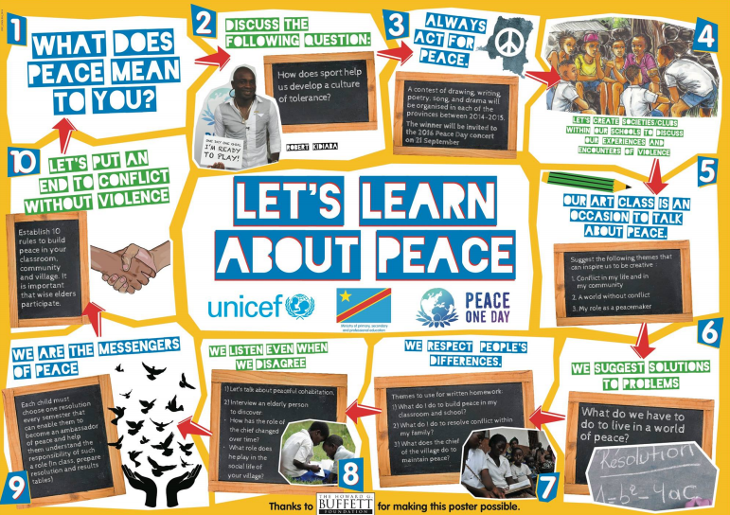
Notes:
Download this poster
http://www.peacedayphilly.org/wp-content/uploads/2014/06/Peace-One-Day-2014-Poster-PDF.pdf

Slide 20
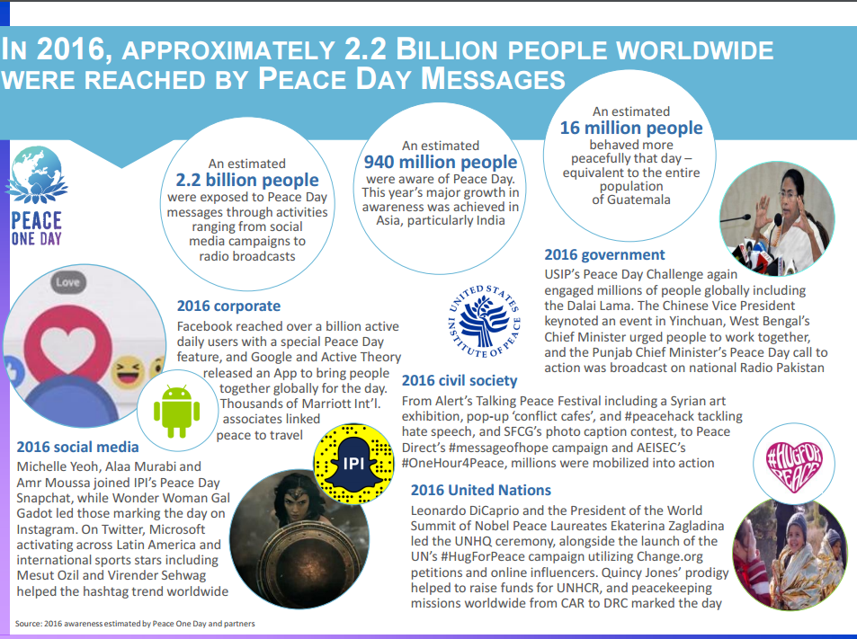
Notes:
http://www.peaceoneday.org/sites/default/files/peace_day_2016_report_summary_03_21_2017_0.pdf

Slide 21
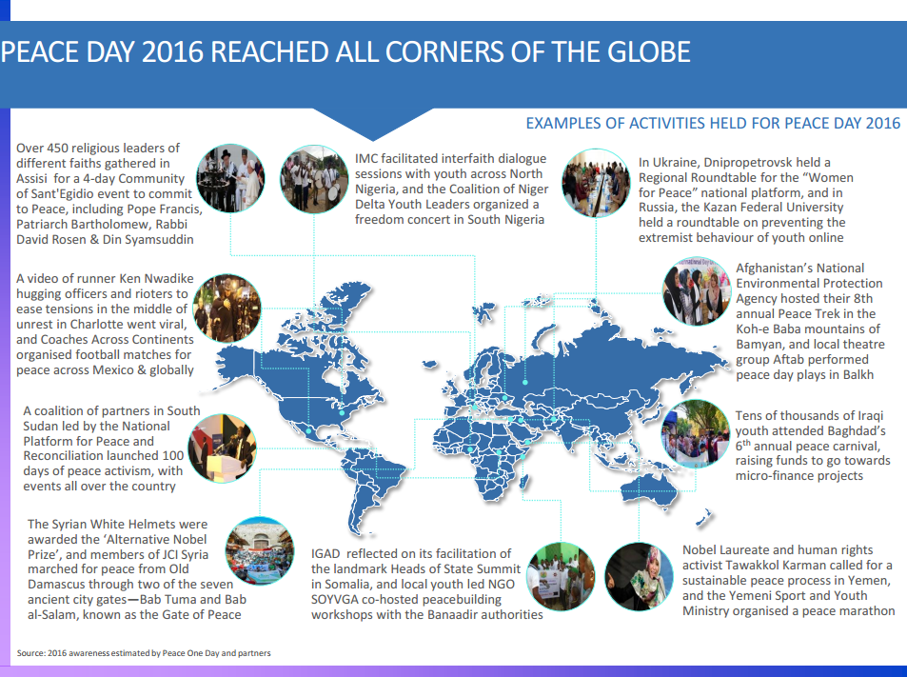
Notes:
http://www.peaceoneday.org/sites/default/files/peace_day_2016_report_summary_03_21_2017_0.pdf

Slide 22
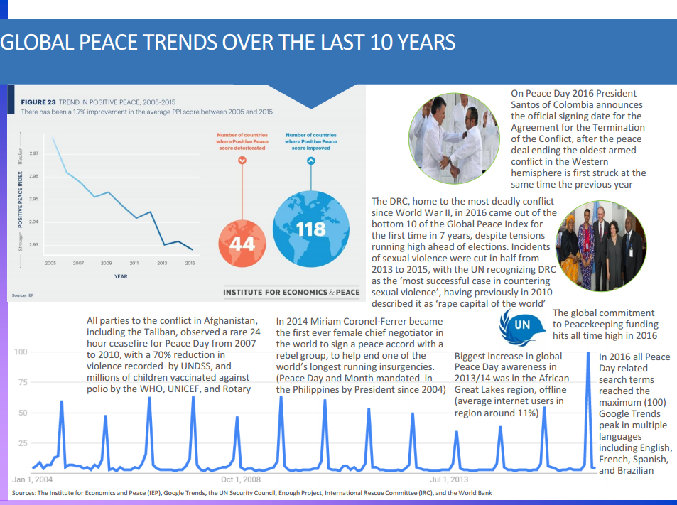
Notes:
http://www.peaceoneday.org/sites/default/files/peace_day_2016_report_summary_03_21_2017_0.pdf

Slide 23
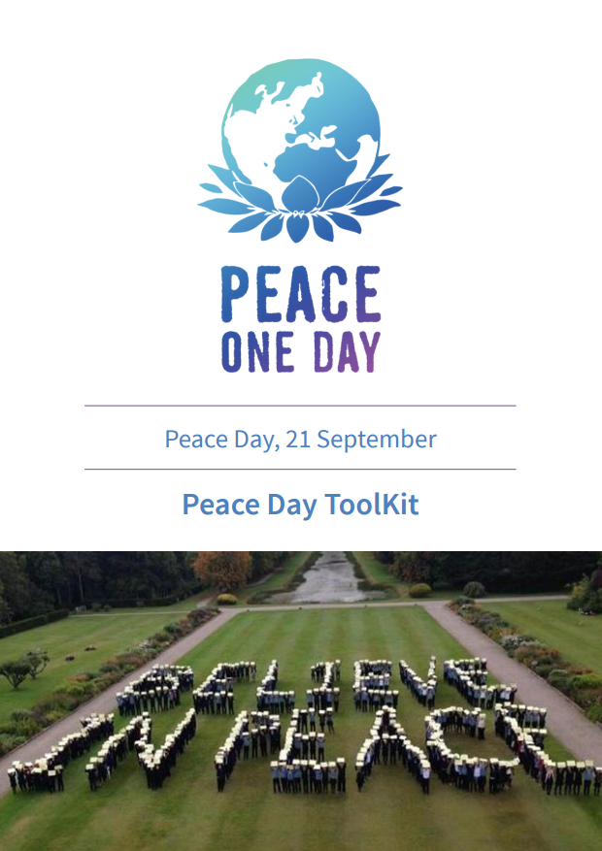
Notes:
http://www.peaceoneday.org/sites/default/files/peace_day_tool_kit.pdf

Slide 24
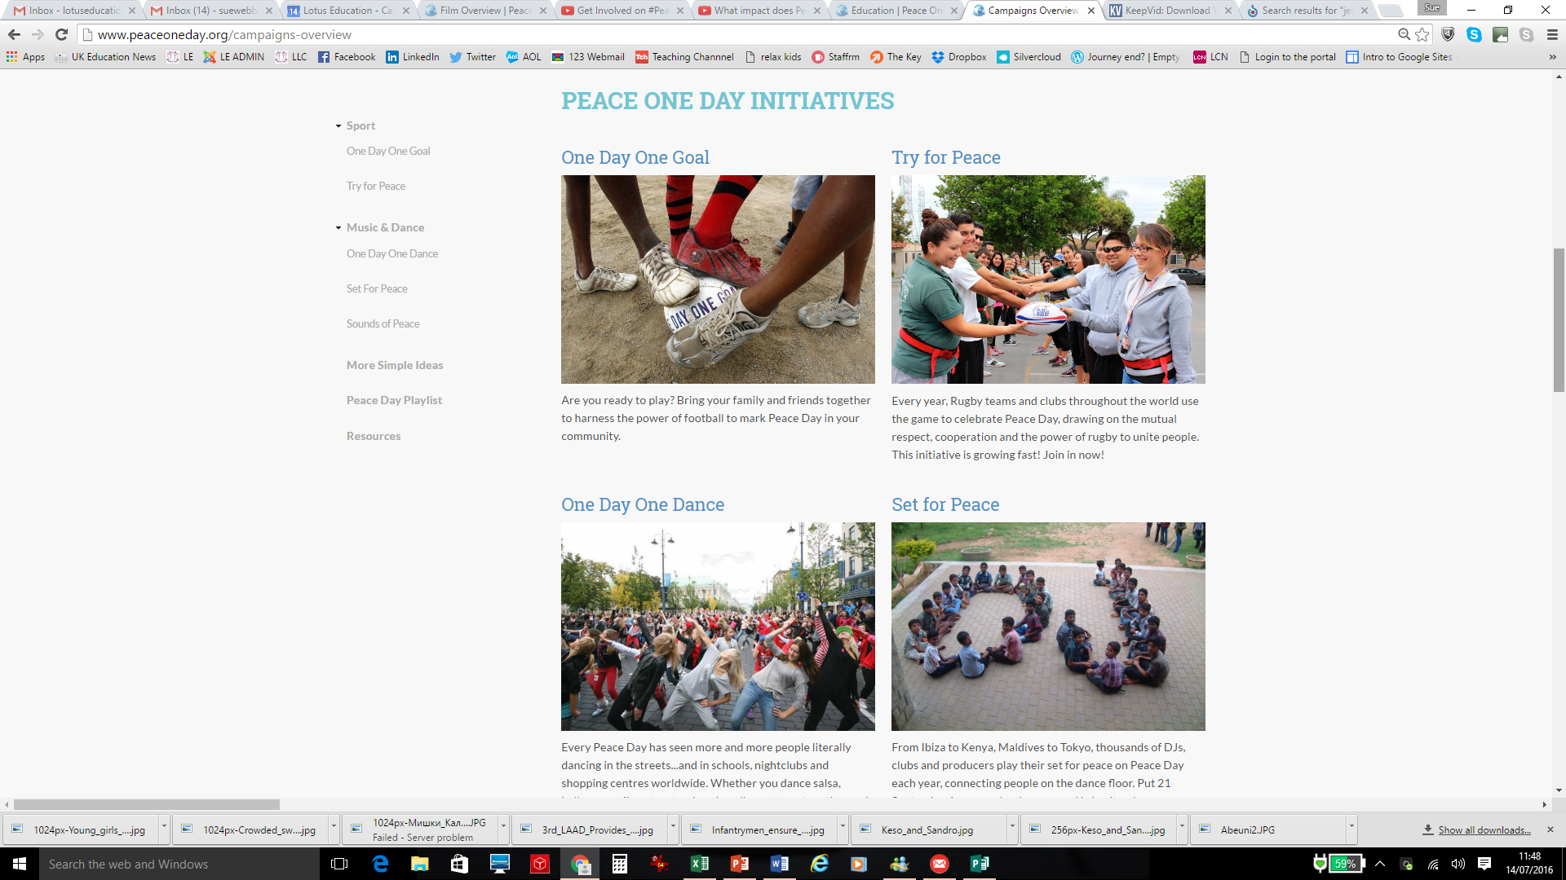
Source: Peace One Day (http://peaceoneday.org)
Notes:
Source: Peace One Day (http://peaceoneday.org)

Slide 25
Source: Peace One Day (http://peaceoneday.org)
Notes:
Source: Peace One Day (http://peaceoneday.org)

Slide 26
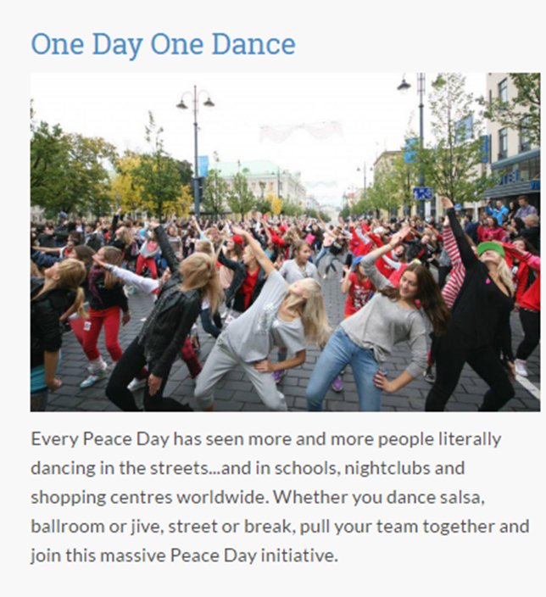
Source: Peace One Day (http://peaceoneday.org)
Notes:
Source: Peace One Day (http://peaceoneday.org)

Slide 27
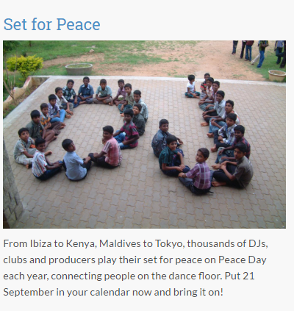
Source: Peace One Day (http://peaceoneday.org)
Notes:
Source: Peace One Day (http://peaceoneday.org)

Slide 28
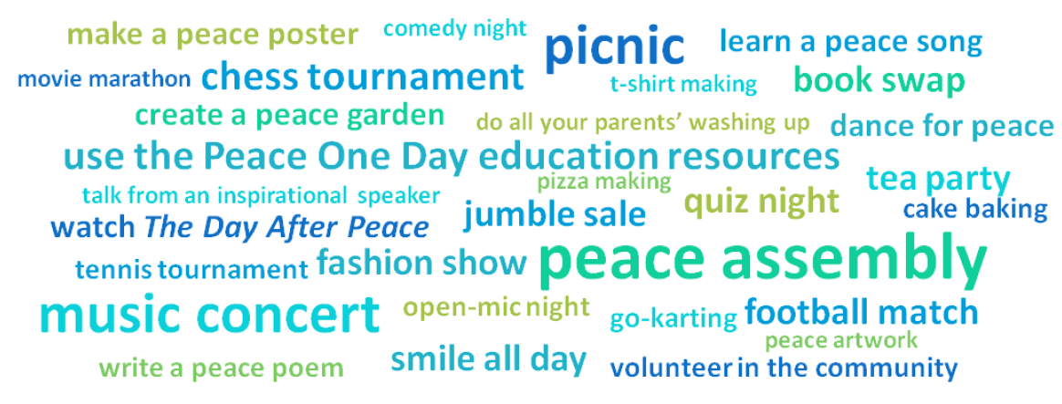
What can we do to create peace in our homes, in our school
and in our community?
#PeaceDay

Slide 29
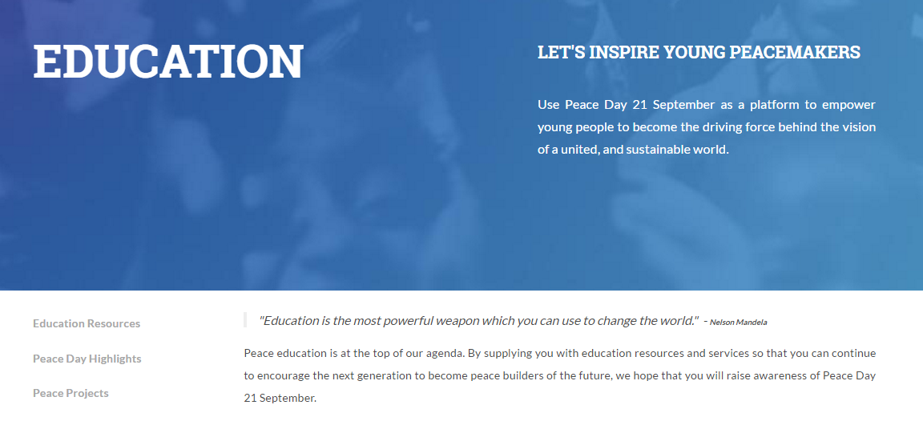
http://www.peaceoneday.org/education
Notes:
A huge section on the website with Educational Resources available.
http://www.peaceoneday.org/education

Slide 30
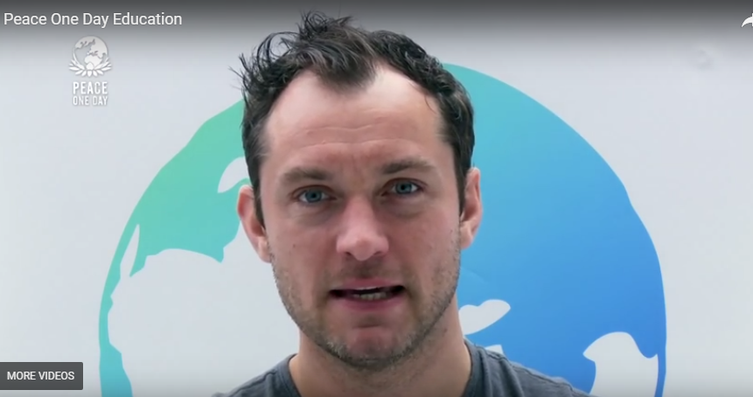
Peace One Day
Education In Schools
Notes:
Watch this short film here https://www.youtube.com/watch?v=MegX_UQ5Frs
and register for the Education Peace Pack via this link
http://www.peaceoneday.org/education

Slide 31
Perhaps we can use the afternoon and Golden Time on Friday as Peace Time.

Slide 32
Peace
Peace begins with a smile
Mother Teresa

Slide 33
Peace
There is no path to peace.
Peace is the path.
Gandhi

Slide 34
Peace
Peace is not merely a distant goal which we seek, but a means by which we arrive at that goal.
Martin Luther King

Slide 35
Peace
If everyone demanded peace instead of another television set, then there’d be peace.
John Lennon

Slide 36
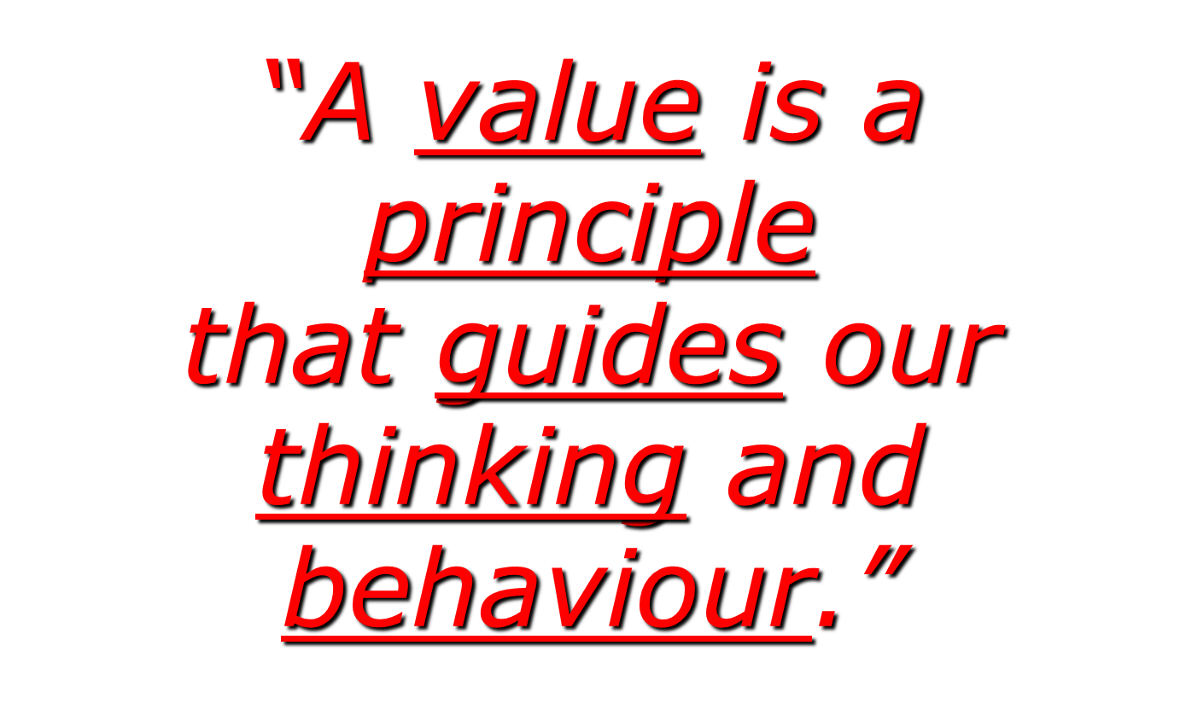
How does Peace do this?

Slide 37



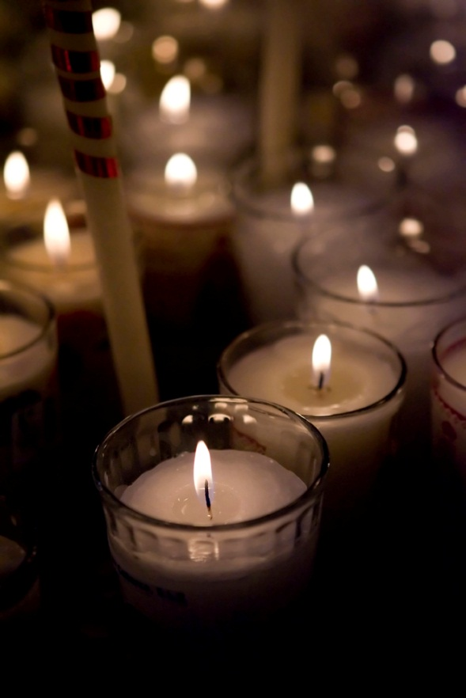




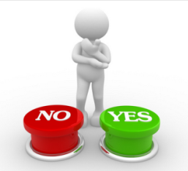


A quiet moment of prayer or reflection...
Peace

Slide 38

A quiet moment of prayer or reflection...
As we reflect, think about how peace makes the world a better place to be.

Slide 39
A prayer for all of us
Here in our school
Let us be peaceful at all times.
Let our rooms be full of happiness
and respect for each other.
Let love be in our hearts
With kindness and compassion for all.
Let us remember
In learning together,
We grow together
And succeed together.
Notes:
Substitute with your own school prayer

Slide 40

Is it important for people to be peaceful towards each other …and why?

Slide 41
How can you help to make your world a more peaceful place?

Slide 42
Do you think there could ever be peace every day in the world?

Slide 43
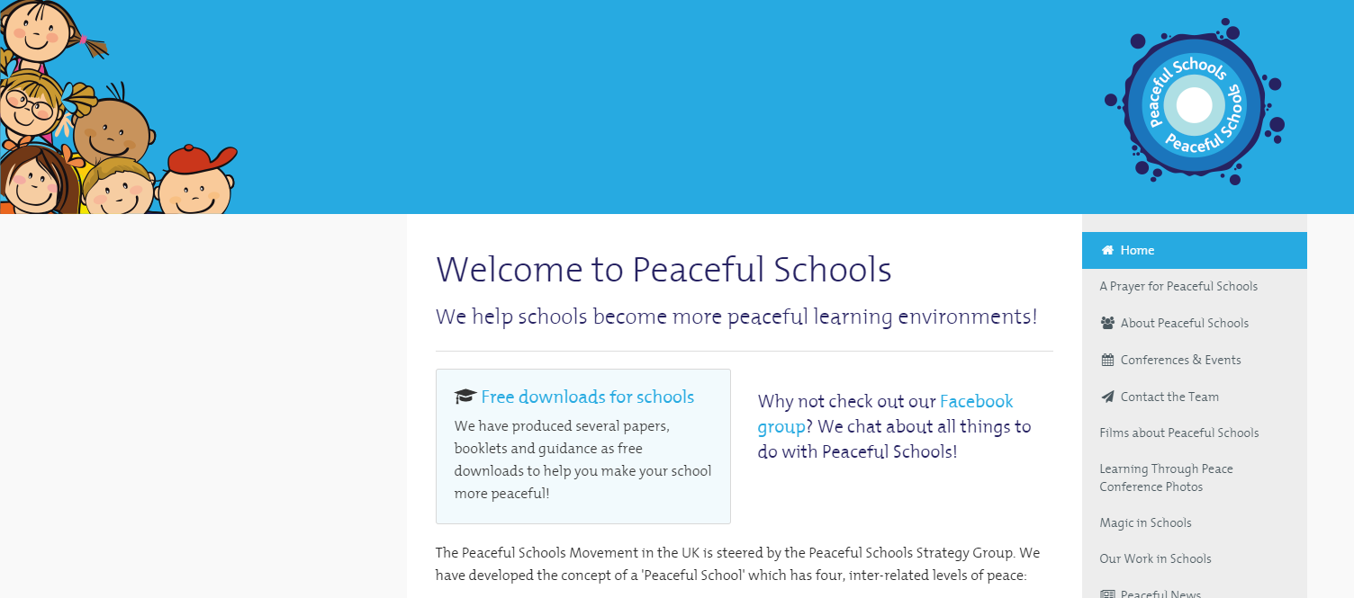
‘Peaceful Schools’
The Peaceful Schools Movement has identified the concept of a 'Peaceful School' which has four, inter-related levels of peace:
Inner peace for the individual pupil/student and members of staff;
Peaceful relationships and constructive resolution of conflicts;
Peaceful school ethos and environment (indoors and outdoors);
Peacemaking within the wider community/world!
www.peacefulschools.org.uk

Slide 44
Have you heard of the musical initiative ‘Playing for Change’?
People singing one song all over the world…
Watch this beautiful version of ‘Imagine’
Notes:
Click on the heart to play hyperlink to
https://www.youtube.com/watch?v=bvFLKyAGzzI

Slide 45

Thank you for listening
so well to our
Values Assembly.
Visit www.valuesbasededucation.com for more Peace and other values resources

